Slide 1
Intel® DevCloud for the Edge
Sign Up Here: https://devcloud.intel.com/edge
Notes:
Again, if you are watching live, you will see a passcode provided for your registration, which will give you 30 days access to DevCloud immediately, if you are on-demand, you can still register an account on DevCloud, but access is not guaranteed. To sign up, please visit: devcloud.intel.com/edge

Slide 2






Test hardware with the intel® devcloud for the edge
Powered by Intel® Distribution of OpenVINO™ toolkit
Prototype on the latest hardware and software to future proof your solution
Benchmark your customized AI application
Run AI applications from anywhere in the world
Help to reduce development time and cost
Trained Model
Model trained using one of the supported frameworks
-or-
Using a pre-trained model available from the Open Model Zoo
Intel® Distribution of OpenVINO™ toolkit
Model Optimizer
Inference Engine
Intel® DevCloud for the Edge
A development sandbox to try AI and vision workloads remotely before purchasing Intel® platforms
https://devcloud.intel.com/edge/
Deploy and Scale
Intel®
GNA
(IP)
Optimization Notice
Copyright © 2020, Intel Corporation. All rights reserved. *Other names and brands may be claimed as the property of others.
Notes:
Before you made your decision on what type of HW satisfies your requirements best, Intel has some tools to get you started.
To help developers test before purchase, Intel provides a platform named “DevCloud for the Edge” for developers to run sample applications across various Intel HW and benchmark their performance. You can also bring your code and prototype your solution on DevCloud. At the end of the live training, we will provide attendees a passcode to register for access to DevCloud. If you are watching an on-demand video now, please ask for a passcode from your Intel representative.

Slide 3
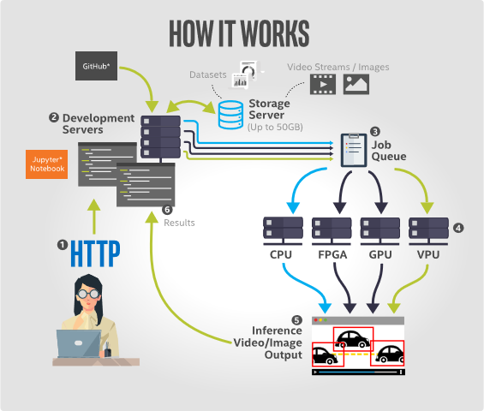
see immediate AI Application performance across Intel’s vast array of Edge Solutions
Accelerate Time to Production with Intel® DevCloud for the Edge
-
Instant, Global Access
Run AI applications from anywhere in the world
-
Prototype on the Latest Hardware and Software
Develop knowing you’re using the latest Intel technology
-
Benchmark your Customized AI Application
Immediate feedback - frames per second, performance
-
Reduce Development Time and Cost
Quickly find the right compute for your edge solution
Sign up now for access
Notes:
The Intel® DevCloud for the Edge allows you to actively prototype and experiment with AI workloads for computer vision on Intel hardware. You have full access to hardware platforms hosted in our cloud environment, designed specifically for deep learning. You can test the performance of your models using the OpenVINO™ Toolkit and combinations of CPUs, GPUs, VPUs and FPGAs.
The DevCloud contains a series of Jupyter* notebook tutorials and examples preloaded with everything you needed to quickly get started. This includes trained models, sample data, and executable code from OpenVINO™ Toolkit as well as other tools for deep learning. These notebooks are designed to help you quickly learn how to implement deep learning applications to enable compelling, high-performance solutions.
There’s No hardware setup required on your end. The DevCloud utilizes Jupyter* Notebooks to execute code directly within the Web browser. Jupyter* is a browser-based development environment that allows you to run code and immediately visualize results. You can prototype innovative computer vision solutions in our cloud environment, then execute your code on any of our available combinations of hardware resources.
The Intel® DevCloud consists of:
Development nodes which you interact with to develop code and submit compute jobs.
Edge nodes that contain inference devices on which you can run and test edge workloads.
Storage servers that provide a network-shared filesystem and all of your data is accessible on the same path from any machine in the cloud.
Queue server with which you interact to submit compute jobs to edge nodes.
UI software that allows you to access the Intel® DevCloud resources from a web browser.

